Slide 1

ISE 218: Fundamentals of Information Technology
Unit 01: Hardware Basics
Spring 2025
Instructor: Abid Malik
co-Instructor: Xinrui Yu

Slide 2
Overview
Computer organization
  Encompasses all physical aspects of computer systems.
  Circuit design, control signals, memory types.
  How does a computer work?
Computer architecture
  Logical aspects of system implementation as seen by the programmer
Both provide a foundation for understanding many aspects of various hardware devices
There is no clear distinction between matters related to computer organization and matters relevant to computer architecture.

Slide 3
Overview
Why study computer hardware, including computer organization and architecture?
  Inform product selection/procurement
  Predict life of devices
  Understand system performance and various trade-offs
  Effectively communicate with vendors / internal CS staff

Slide 4
Computer Systems
At the most basic level, a computer is a device consisting of three pieces:
  A processor to interpret and execute programs
  A memory to store both data and programs
  A mechanism for transferring data to and from the outside world
The processor has several sub-parts we will see later in this Unit:
  Arithmetic/logic unit (ALU), which does the computations
  Control unit, which directs the operation of the processor
  Registers, small memory banks for temporarily holding data values

Slide 5
Computer Systems
The memory is arranged in a hierarchy:
  Registers: small, fast, temporary storage
  Main memory: larger, slower, temporary storage
  Hard disks/solid state disks: much larger, slower, permanent storage
All these various components are connected via communication lines called buses

Slide 6
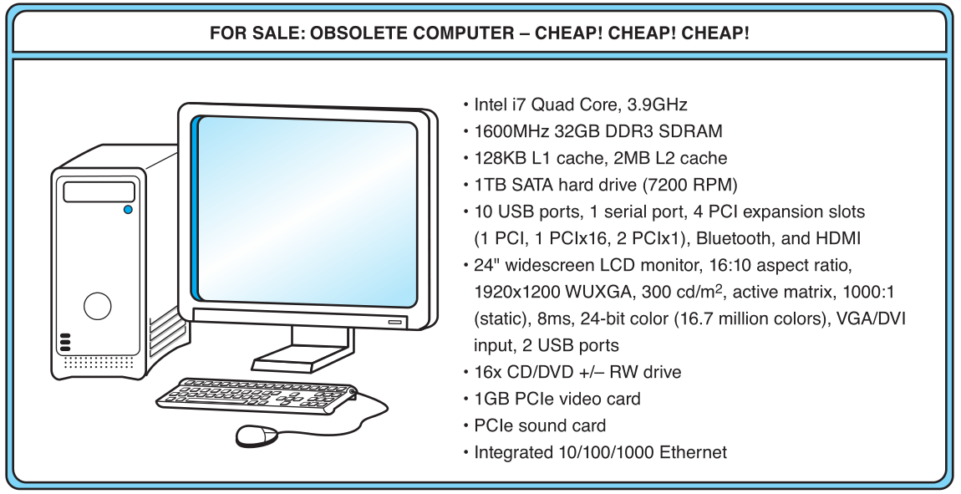
An Example System
GB?
L1 Cache?
PCI?
SATA?
What does all this jargon mean???

Slide 7
Units of Measure
Measures of capacity and speed:
  Kilo- (K) = 1 thousand = 10³ and 2¹⁰
  Mega- (M) = 1 million = 10⁶ and 2²⁰
  Giga- (G) = 1 billion = 10⁹ and 2³⁰
  Tera- (T) = 1 trillion = 10¹² and 2⁴⁰
  Peta- (P) = 1 quadrillion = 10¹⁵ and 2⁵⁰
  Exa- (E) = 1 quintillion = 10¹⁸ and 2⁶⁰
  Zetta- (Z) = 1 sextillion = 10²¹ and 2⁷⁰
  Yotta- (Y) = 1 septillion = 10²⁴ and 2⁸⁰
Whether a metric refers to a power of ten or a power of two typically depends upon what is being measured.

Slide 8
An Example System
Hertz = clock cycles per second (frequency)
  1MHz = 1,000,000Hz
  Processor speeds are measured in MHz or GHz.
Byte = a unit of storage
  1 byte = 8 bits (bit is short for binary digit, a single 0 or 1)
  1KB = 2¹⁰ = 1024 bytes
  1MB = 2²⁰ = 1,048,576 bytes
  1GB = 2³⁰ = 1,073,741,824 bytes
  Main memory (RAM) is measured in GB
  Disk storage is measured in GB for small systems, TB (2⁴⁰) for large systems.

Slide 9
Units of Measure
Measures of time and space:
    Milli- (m) = 1 thousandth = 10⁻³
    Micro- (μ) = 1 millionth = 10⁻⁶
    Nano- (n) = 1 billionth = 10⁻⁹
    Pico- (p) = 1 trillionth = 10⁻¹²
    Femto- (f) = 1 quadrillionth = 10⁻¹⁵
    Atto- (a) = 1 quintillionth = 10⁻¹⁸
    Zepto- (z) = 1 sextillionth = 10⁻²¹
    Yocto- (y) = 1 septillionth = 10⁻²⁴

Slide 10
Units of Measure
Millisecond = 1 thousandth of a second
  Hard disk drive access times are often 10 to 20 milliseconds.
Nanosecond = 1 billionth of a second
  Main memory access times are often 50 to 70 nanoseconds.
Micron (micrometer) = 1 millionth of a meter
  Circuits on computer chips are measured in microns.
We note that cycle time is the reciprocal of clock frequency.
A system bus operating at 133MHz has a cycle time of 7.52 nanoseconds:
  133,000,000 cycles/second = 7.52ns/cycle

Slide 11
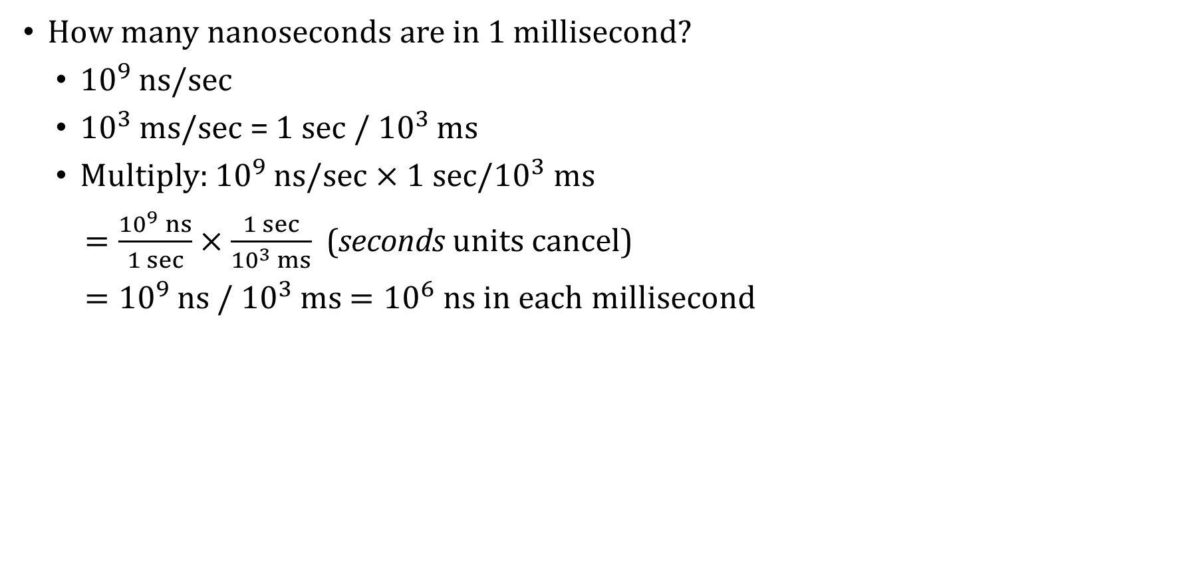
Units of Measure: Example #1
How many nanoseconds are in 1 millisecond?
  ${10}^{9}$ ns/sec
  ${10}^{3}$ ms/sec = 1 sec / ${10}^{3}$ ms
  Multiply: ${10}^{9}$ ns/sec $×$ ${1 sec/10}^{3}$ms
  $=\frac{{10}^{9} ns}{1 sec}×\frac{1 sec}{{10}^{3} ms}$ (seconds units cancel)
  ${=10}^{9}$ns / ${10}^{3}$ ms $={10}^{6}$ ns in each millisecond

Slide 12
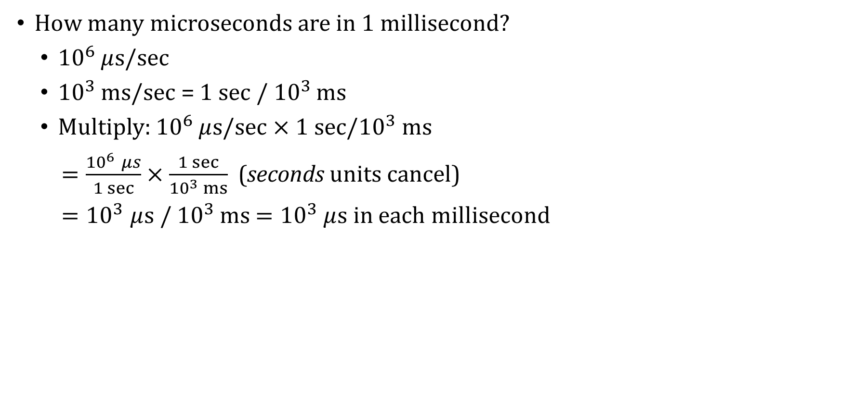
Units of Measure: Example #2
How many microseconds are in 1 millisecond?
  ${10}^{6}$ $μ$s/sec
  ${10}^{3}$ ms/sec = 1 sec / ${10}^{3}$ ms
  Multiply: ${10}^{6}$ $μ$s/sec $×$ ${1 sec/10}^{3}$ ms
  $=\frac{{10}^{6} μs}{1 sec}×\frac{1 sec}{{10}^{3} ms}$ (seconds units cancel)
  ${=10}^{3}μ$s / ${10}^{3}$ ms $={10}^{3}$ $μ$s in each millisecond

Slide 13
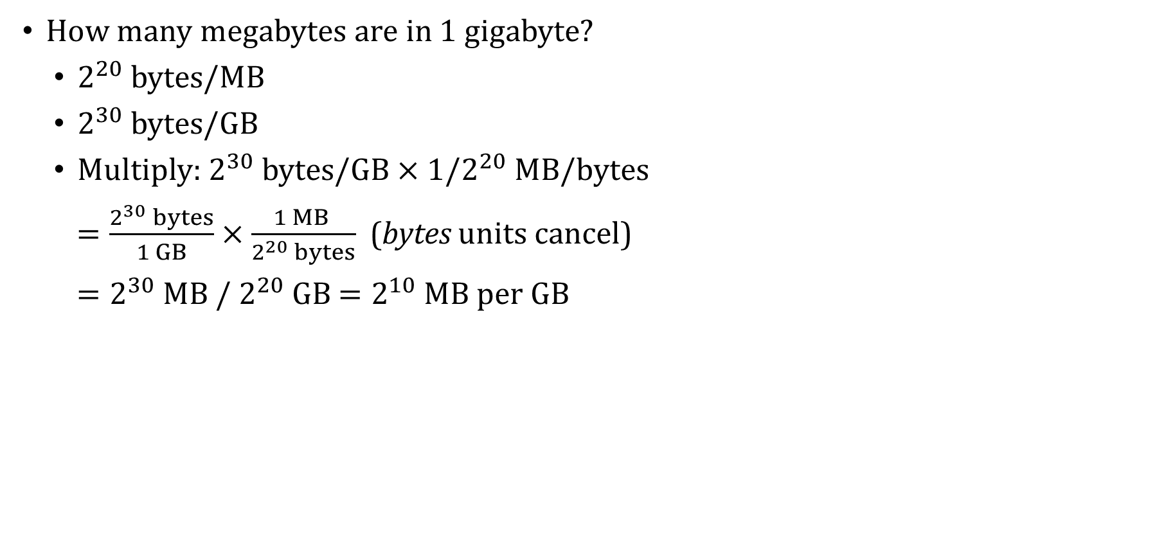
Units of Measure: Example #3
How many megabytes are in 1 gigabyte?
  $2^{20}$ bytes/MB
  $2^{30}$ bytes/GB
  Multiply:$2^{30} \text{bytes}\text{/}\text{G}\text{B}×\text{1/}2^{20} \text{M}\text{B}\text{/}\text{bytes}$
  $=\frac{2^{30} bytes}{1 GB}×\frac{1 MB }{2^{20} bytes}$ (bytes units cancel)
  $=2^{30}$MB / $2^{20}$ GB $=2^{10}$ MB per GB

Slide 14
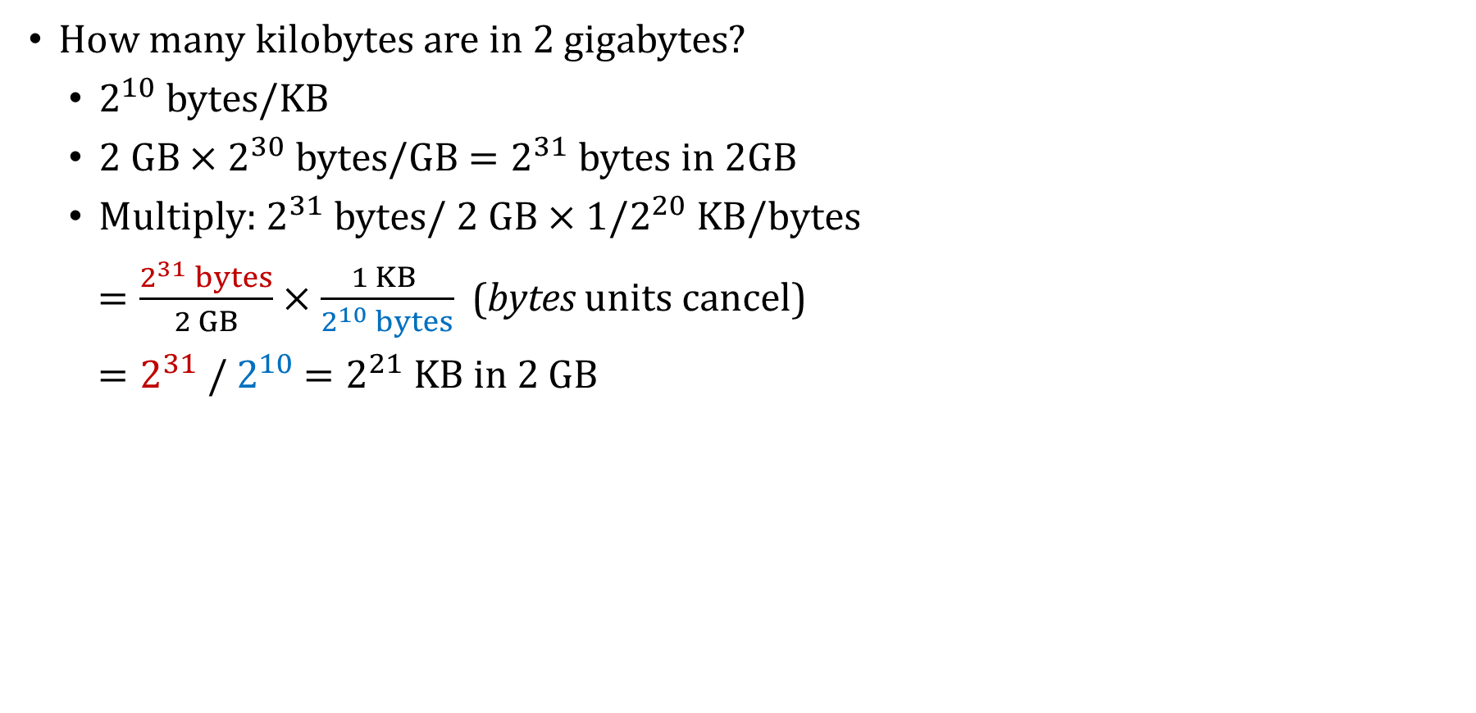
Units of Measure: Example #4
How many kilobytes are in 2 gigabytes?
  $2^{10}$ bytes/KB
  2 GB $×$ $2^{30}$ bytes/GB $=2^{31}$ bytes in 2GB
  Multiply:$2^{31} \text{bytes}\text{/ 2 }\text{GB}×\text{1/}2^{20} \text{K}\text{B}\text{/}\text{bytes}$
  $=\frac{2^{31} bytes}{2 GB}×\frac{1 KB }{2^{10} bytes}$ (bytes units cancel)
  $=2^{31}$/ $2^{10}$ $=2^{21}$ KB in 2 GB

Slide 15
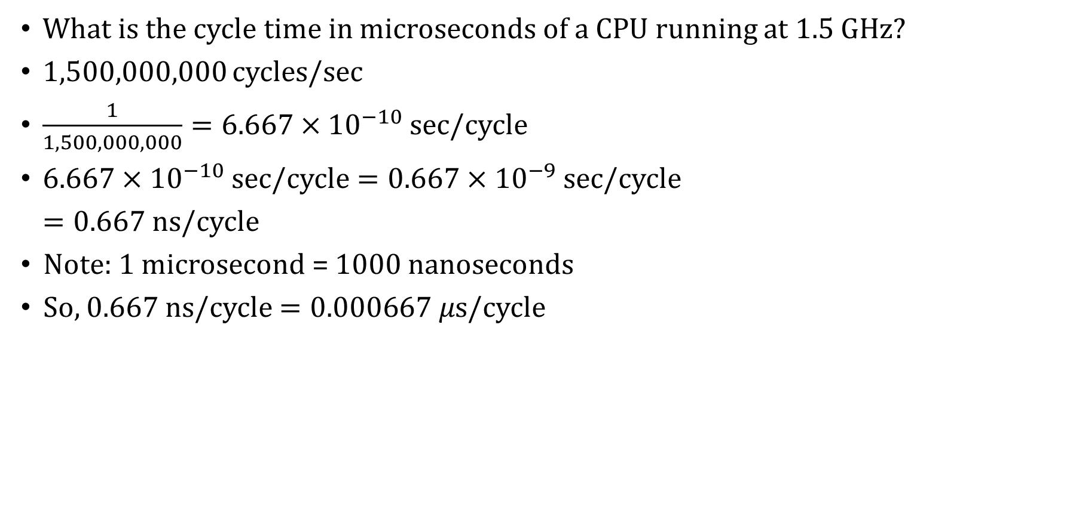
Units of Measure: Example #5
What is the cycle time in microseconds of a CPU running at 1.5 GHz?
1,500,000,000 cycles/sec
$\frac{1}{1,500,000,000}=6.667×{10}^{−10}$ sec/cycle
$6.667×{10}^{−10}$ sec/cycle $=0.667×{10}^{−9}$ sec/cycle
$=0.667$ ns/cycle
Note: 1 microsecond = 1000 nanoseconds
So, $0.667$ ns/cycle$=0.000667 μ$s/cycle

Slide 16
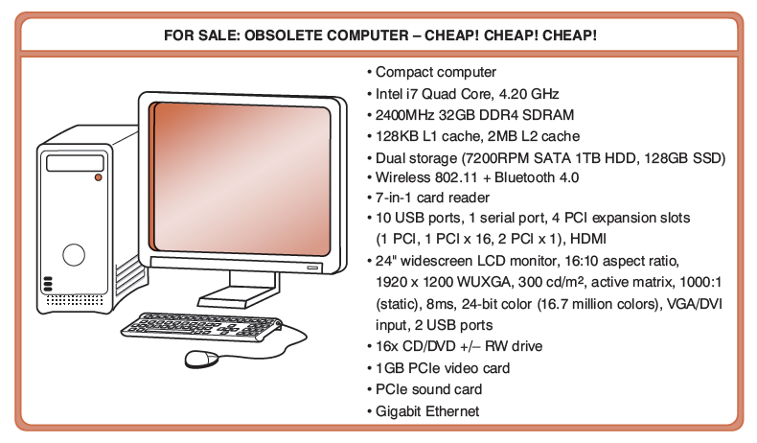
An Example System
This computer has a compact form factor.

Slide 17
An Example System
The microprocessor is the “brain” of the system. It executes instructions. This one has an Intel i7 with four computing cores running at 4.2 GHz.

Slide 18
An Example System
This system has 32 GB of (fast) RAM and two levels of cache. L1 cache is smaller and faster than the L2 cache. Note the size units: KB/MB.

Slide 19
An Example System
Computers with large main memory capacity can run larger programs with greater speed than computers having small memories.
RAM is an acronym for random access memory. Random access means that memory contents can be accessed directly if you know its location.
Cache is a type of temporary memory that can be accessed faster than RAM.

Slide 20
An Example System
The system bus is running at 2400 MHz, a measure of how fast the CPU and RAM can communicate with each other.

Slide 21
An Example System
The hard disk can store 1 TB of data. The system also has a faster, smaller solid state drive (128 GB).

Slide 22
An Example System
SATA is serial advanced technology attachment, which describes how the hard drive connects to other system components.
A DVD can store about 4.7 GB of data. This drive supports re-writeable discs.

Slide 23
An Example System
Ports allow movement of data between a system and its external devices. This system has 12 ports and 4 expansion slots.

Slide 24
An Example System
System buses can be augmented by dedicated I/O buses, like PCI. This system also has two PCIe devices: a video card and a sound card.

Slide 25
An Example System
The computer’s monitor has 1920 x 1200 resolution (measured in pixels) and is supported by the video card.

Slide 26
An Example System
The system has support for both wireless and wired communication, and for short-range wireless communication via Bluetooth.

Slide 27
An Example System
A card reader makes it easier to transfer photos and other files from Secure Digital and other kinds of memory cards.

Slide 28
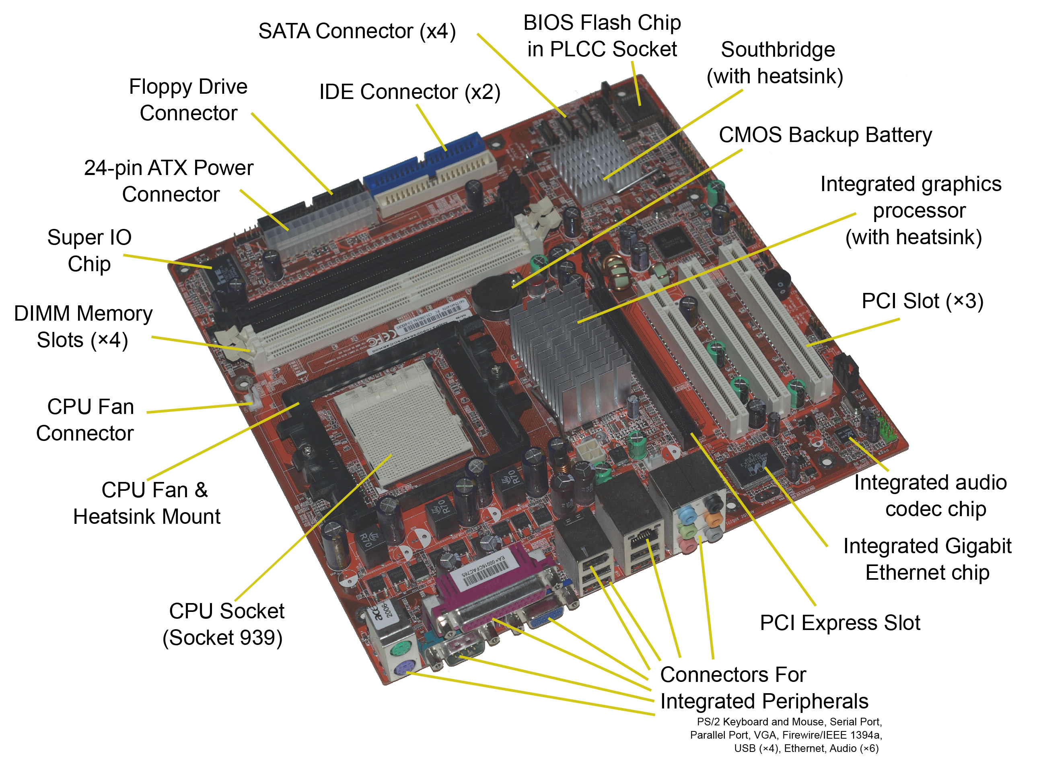
Notes:
southbridge – (I/O controller hub) circuit that allows slower I/O devices
northbridge – connected to front-side bus, handles communication among CPU, RAM (maybe), and PCIe graphics cards
super I/O chip – for controlling keyboard, mouse, floppy disk drives (slow devices)

Slide 29
An Example System
Throughout the remainder of the course you will see how these components work and how they interact with software to make complete computer systems.
This statement raises two important questions:
  What assurance do we have that computer components will operate as we expect?
  And what assurance do we have that computer components will operate together?

Slide 30



Standards Organizations
There are many organizations that set computer hardware standards, including standards to ensure the interoperability of computer components.
Some of the most important standards-setting groups are:
  The Institute of Electrical and Electronic Engineers (IEEE)
    Establishes standards for computer components, data
    representation, and signaling protocols, among many other things.
The International Telecommunications Union (ITU)
  Concerns itself with the interoperability of telecommunications
  systems, including data communications and telephony.
The International Organization for Standardization (ISO)
  Is influential in formulating standards for computer hardware
  and software, including their methods of manufacture.

Slide 31
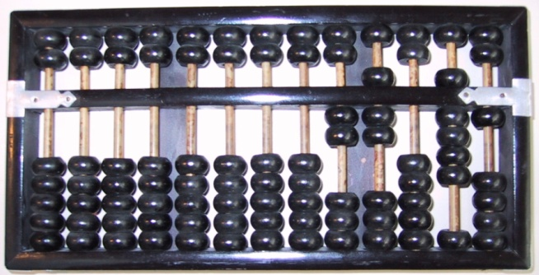
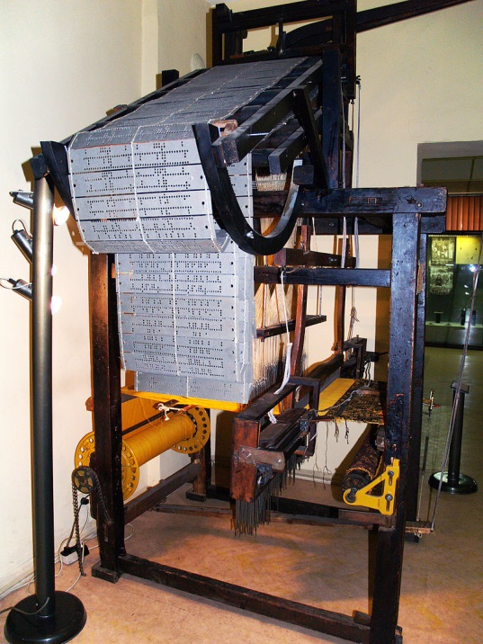
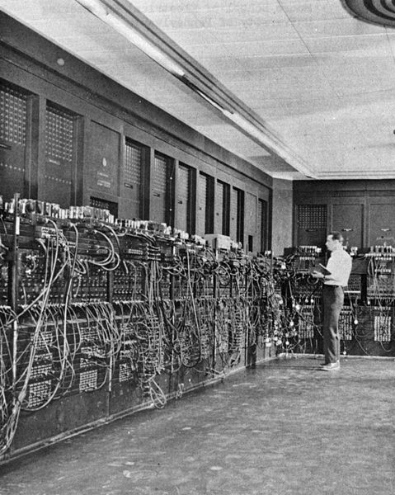
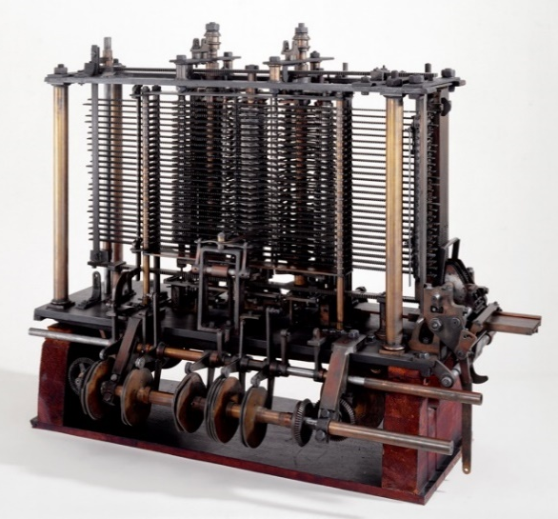
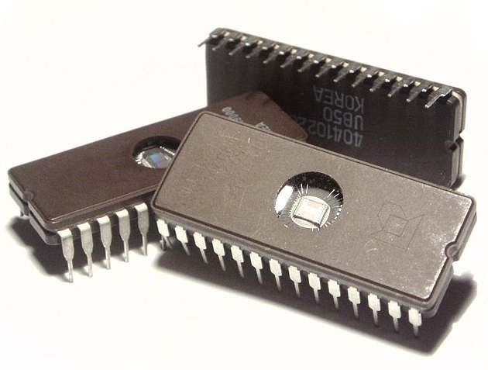
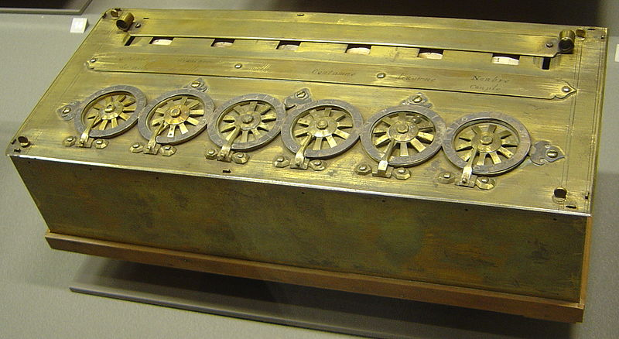
A Quick History of Computing
Notes:
Abaqus
Pascal’s calculator
Jacquard loom 雅卡尔织布机
巴比奇分析机
Electronic Numerical Integrator and Computer

Slide 32
Transistors
As manufacturing technologies improved in the 1950s and 1960s, engineers were able to pack many more transistors per unit area on silicon wafers
Moore’s law: Moore observed that the number of components within an integrated circuit was doubling every 18 months, a trend which has continued pretty steadily since then. But transistors can be only so small!
To combat miniaturization challenges, manufacturers like Intel and AMD (Advanced Micro Devices) now make processors that feature multiple processing cores that perform calculations in parallel

Slide 33
Transistors
Rock’s Law
  Arthur Rock, Intel financier
  “The cost of capital equipment to build semiconductors will double every 4 years.”
In 1968, a new chip plant cost about $12,000.
At the time, $12,000 would buy a nice home in the suburbs.
In 2012, a chip plant’s construction cost well over $5 billion.
  $5 billion is more than the gross domestic product of some small countries, including Barbados, Mauritania, and Rwanda.
For Moore’s Law to hold, Rock’s Law must fall, and vice versa. But no one can say which will give out first.

Slide 34
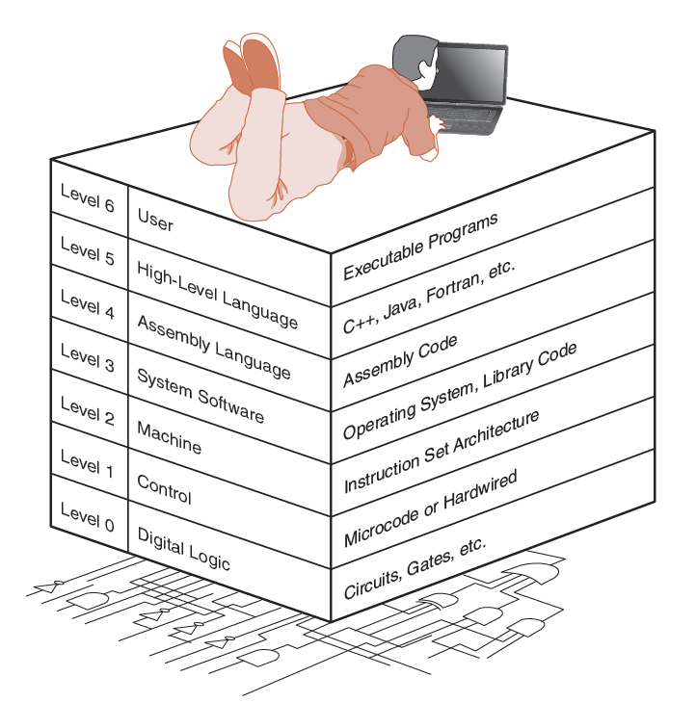
The Computer Level Hierarchy
Computers consist of many things besides chips.
Before a computer can do anything worthwhile, it must also use software.
Writing complex programs requires a “divide and conquer” approach, where each program module solves a smaller problem.
Complex computer systems employ a similar technique through a series of virtual machine layers.

Slide 35
The Computer Level Hierarchy
Each virtual machine layer is an abstraction of the level below it.
The machines at each level execute their own particular instructions, calling upon machines at lower levels to perform tasks as required.
Computer circuits ultimately carry out the work.

Slide 36
The Computer Level Hierarchy
Level 6: The User Level
  Program execution and user interface level.
  The level with which we are most familiar.
Level 5: High-Level Language Level
  The level with which we interact when we write programs in languages such as Python and Java.
  Must be translated into lower-level languages that the computer “understands”.

Slide 37
The Computer Level Hierarchy
Level 4: Assembly Language Level
  Acts upon assembly language produced from Level 5, as well as instructions programmed directly at this level.
Level 3: System Software Level
  Controls executing processes on the system.
  Protects system resources.
  The operating system is at this level.

Slide 38
The Computer Level Hierarchy
Level 2: Machine Level
  Also known as the Instruction Set Architecture (ISA) Level.
  Consists of instructions that are particular to the architecture of the machine.
  Programs written in machine language need no compilers, interpreters, or assemblers.
Level 1: Control Level
  A control unit decodes and executes instructions and moves data through the system.

Slide 39
The Computer Level Hierarchy
Level 0: Digital Logic Level
  This level is where we find digital circuits (the chips).
  Digital circuits consist of electronic components and wires.
  These components implement the mathematical logic of all other levels.

Slide 40
The von Neumann Model
On the ENIAC (Electronic Numerical Integrator and Computer), all programming was done at the digital logic level (i.e., the circuits had to be changed to reprogram the computer).
Programming the computer involved moving plugs and wires.
A different hardware configuration was needed to solve every unique problem type.
Configuring the ENIAC to solve a “simple” problem required many days of labor by skilled technicians.

Slide 41
The von Neumann Model
Inventors of the ENIAC, John Mauchley and J. Presper Eckert, conceived of a computer that could store data and instructions in memory.
  This concept is known as a stored-program computer.
The invention of this idea has since been ascribed to a mathematician, John von Neumann, who was a contemporary of Mauchley and Eckert.
Stored-program computers have become known as von Neumann Architecture systems.

Slide 42
The von Neumann Model
Today’s stored-program computers have the following characteristics:
  Three hardware systems:
    A central processing unit (CPU)
    A main memory system
    An I/O system
  The capacity to carry out sequential (as opposed to parallel) instruction processing.
  A single data path between the CPU and main memory.
    This single path is known as the von Neumann bottleneck.

Slide 43
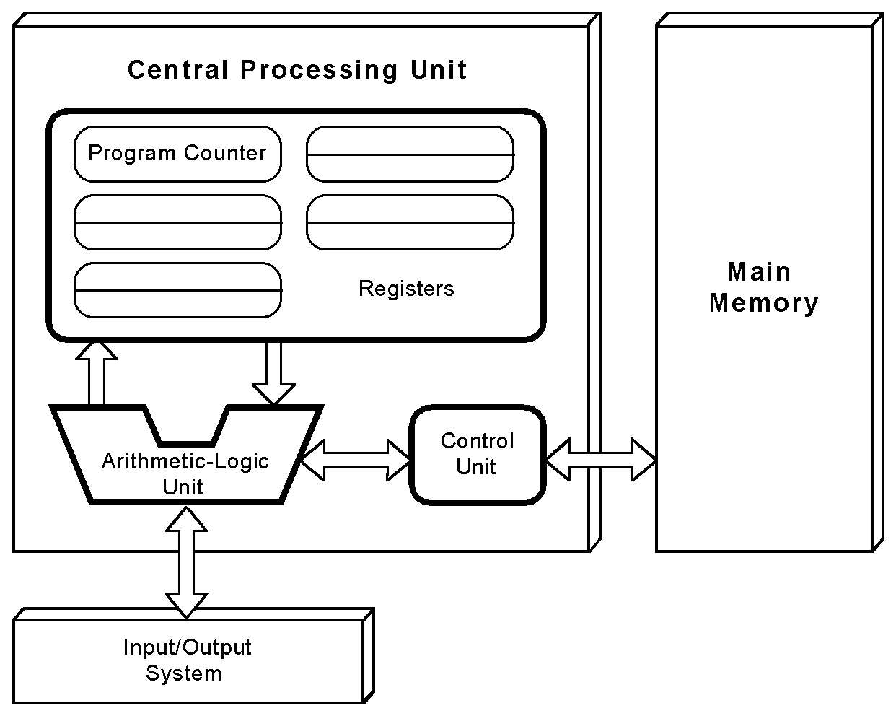
The von Neumann Model
This is a general depiction of a von Neumann system:
These computers employ a fetch-decode-execute cycle

Slide 44
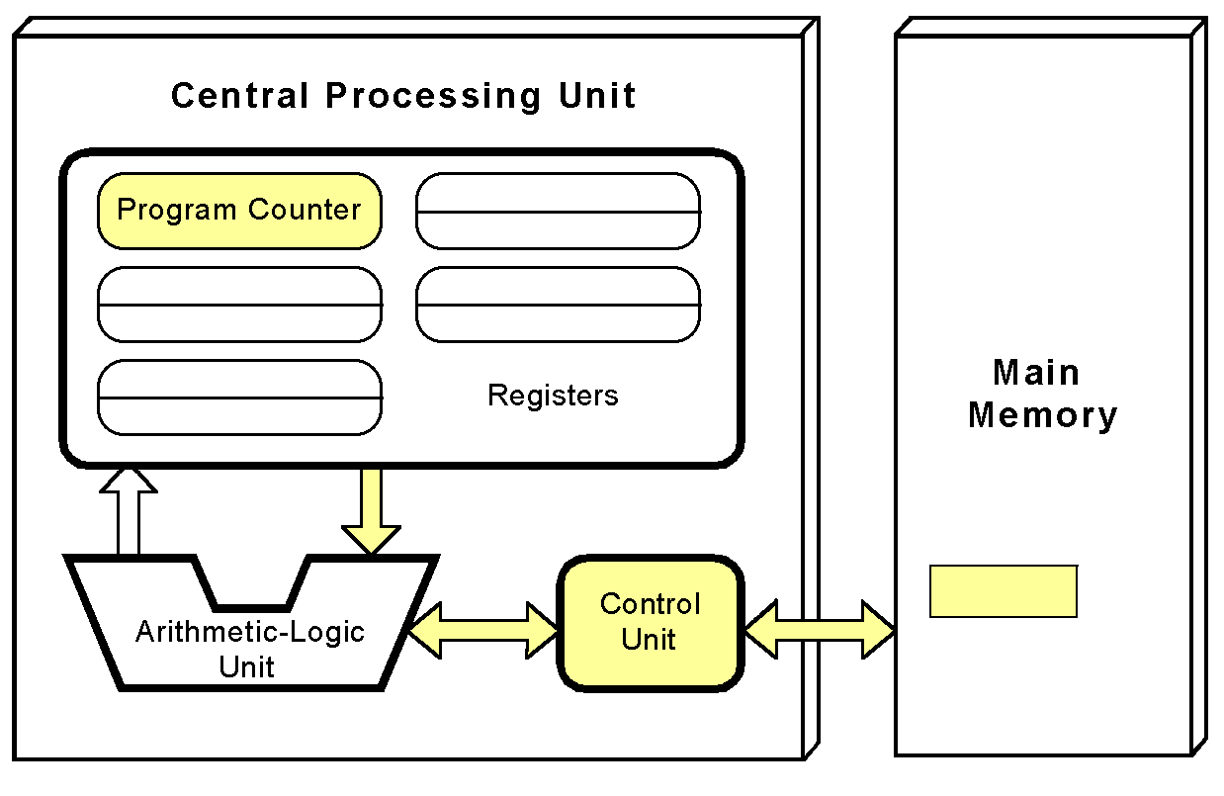
The von Neumann Model
The control unit fetches the next instruction from memory using the program counter to determine where the instruction is located.
The program counter is a small memory bank that “points” to a location in the main memory where the instruction is located.

Slide 45
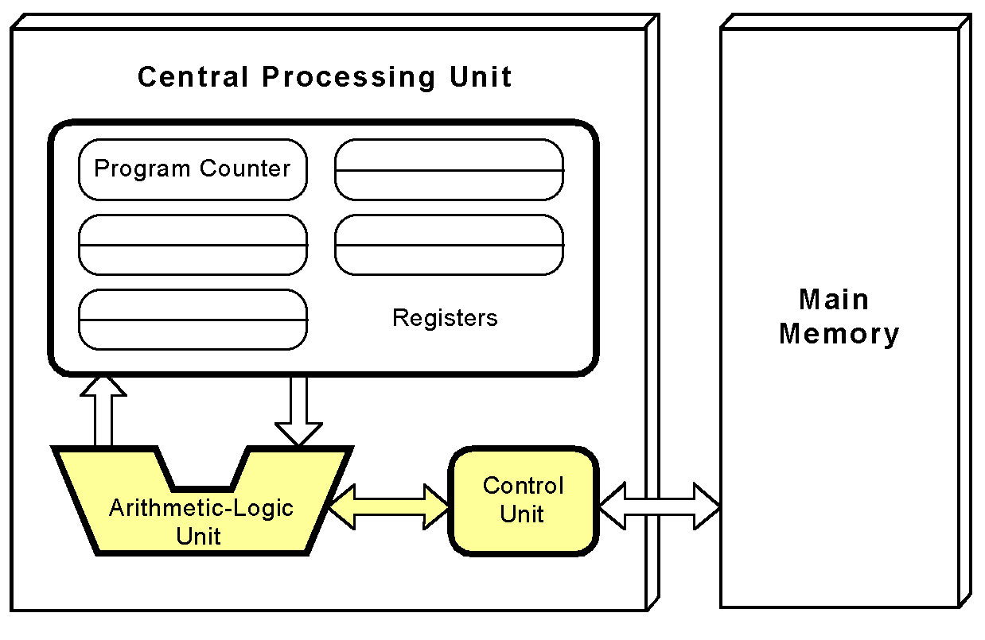
The von Neumann Model
The instruction is decoded into a language that the arithmetic/logic unit can understand.

Slide 46
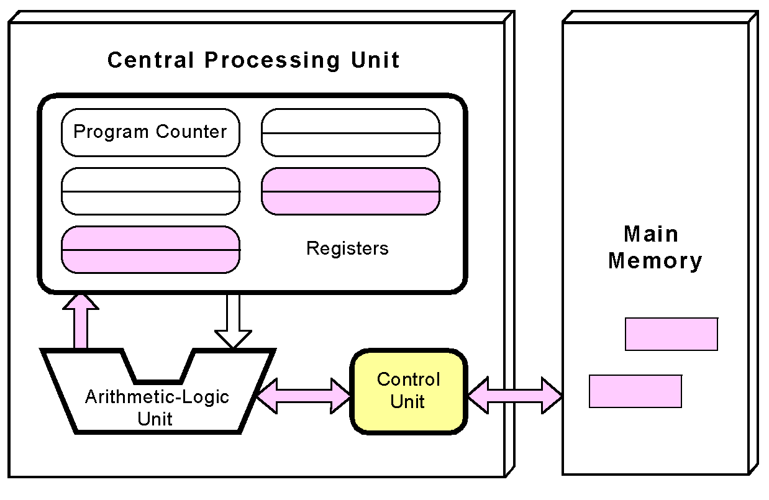
The von Neumann Model
Any data operands required to execute the instruction are fetched from memory and placed into registers within the CPU.
Registers are small memory banks located in the CPU that can store the operands of operations and the results of operations.

Slide 47
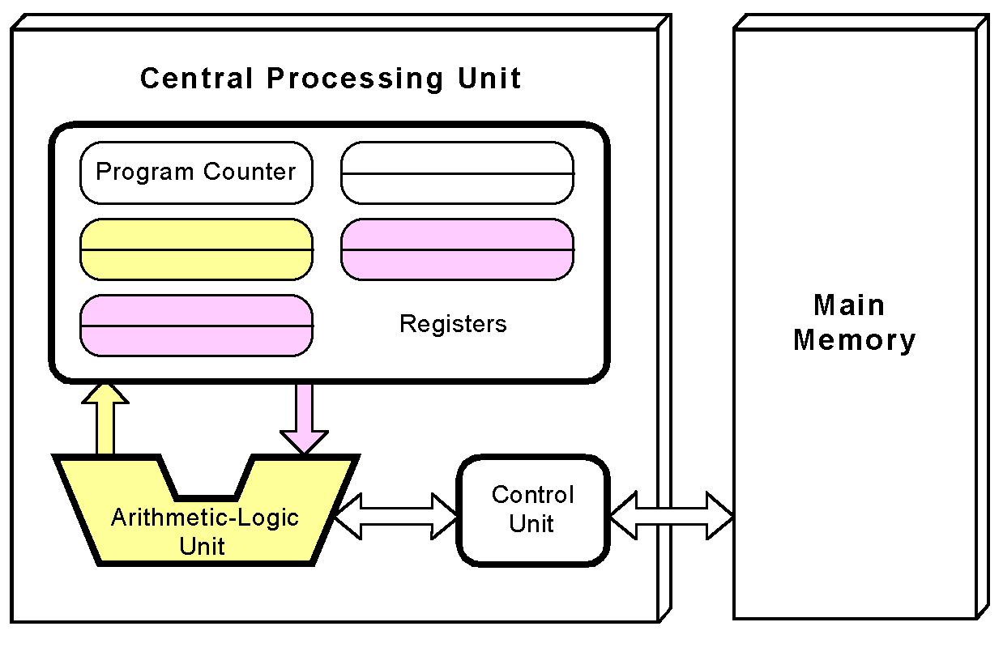
The von Neumann Model
The ALU executes the instruction and places results in registers or memory.

Slide 48
Non-von Neumann Models
Conventional stored-program computers have undergone many incremental improvements over the years.
These improvements include adding specialized buses, floating-point units (for doing fast calculations involving real numbers), and cache memories, to name only a few.
But enormous improvements in computational power require departure from the classic von Neumann architecture.
Adding processors is one approach.
Modern computers have multiple buses (e.g., graphics, I/O)
Other non-von Neumann systems provide special-purpose processors to offload work from the main CPU.
More radical departures include parallel computing.

Slide 49
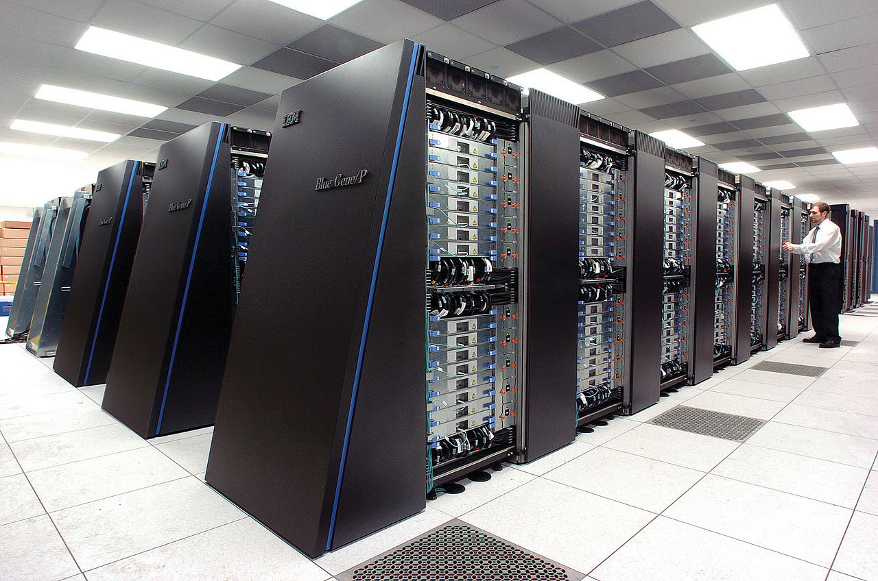
Parallel Computing
In the late 1960s, high-performance computer systems were equipped with dual processors to increase computational throughput.
In the 1970s supercomputer systems were introduced with 32 processors.
Supercomputers with 1,000 processors were built in the 1980s.
In 1999, IBM announced its Blue Gene system containing over 100,000 processors.

Slide 50
Parallel Computing
Parallel processing allows a computer to simultaneously work on subparts of a problem.
Multicore processors have two or more processor cores sharing a single die.
Each core has its own ALU and set of registers, but all processors share memory and other resources.
“Dual core” differs from “dual processor.”
  Dual-processor machines, for example, have two processors, but each processor plugs into the motherboard separately.
  Multi-core systems provide the ability to multitask
    e.g., browse the Web while burning a CD
Multithreaded applications spread mini-processes, threads, across one or more processors for increased throughput.

Slide 51
Parallel Computing: Machine Intelligence
The quest for machine intelligence has been ongoing for over 300 years.
The 20th Century witnessed the first machines that could be human grandmasters at chess when Deep Blue beat Garry Kasparov in 1997.
But the machine and the algorithm relied on a brute force solution, although impressive, is hardly “intelligent” by any measure.
Any definition of true machine “intelligence” would have to include the ability to acquire new knowledge independent of direct human intervention, and the ability to solve problems using incomplete and perhaps contradictory information.
This is precisely what IBM achieved when it build the machine named Watson.
Watson proved this when it beat two human Jeopardy! champions on February 16, 2011.

Slide 52
Parallel Computing: Machine Intelligence
Watson had a massively parallel architecture dubbed DeepQA (Deep Question and Answer).
The system relied on 90 IBM POWER 750 servers.
Each server was equipped with four POWER7 processors, and each POWER7 processor had eight cores, giving a total of 2880 processor cores.
While playing Jeopardy!, each core had access to 16TB of main memory and 4TB of storage.
Watson's technology has been put to work in treating cancer.
  Commercial products based on Watson technology, including “Interactive Care Insights for Oncology” and “Interactive Care Reviewer,” are now available.
Watson is also becoming more compact: Watson can now be run on a single POWER 750 server.

Slide 53
Computing as a Service: Cloud Computing
The ultimate aim of every computer system is to deliver functionality to its users.
Computer users typically do not care about terabytes of storage and gigahertz of processor speed.
Many companies outsource their data centers to third-party specialists, who agree to provide computing services for a fee.
These arrangements are managed through service-level agreements (SLAs).
Rather than pay a third party to run a company-owned data center, another approach is to buy computing services from someone else’s data center and connect to it via the Internet.
This is the idea behind a collection of service models known as Cloud computing.

Slide 54
Computing as a Service: Cloud Computing
The “Cloud” is a visual metaphor traditionally used for the Internet. It is even more apt for service-defined computing.
Software as a Service, or SaaS. The consumer of this service buys application services
  Well-known examples include Gmail, Dropbox, GoToMeeting, and Netflix.
  Pre-made software with little customization possible by customer
  Why buy Saas?
Platform as a Service, or PaaS. Provides server hardware, operating systems, database services, security components, and backup and recovery services.
  Well-known PaaS providers include Google App Engine and Microsoft Windows Azure Cloud Services.

Slide 55
Computing as a Service: Cloud Computing
Infrastructure as a Service (IaaS) provides only server hardware, secure network access to the servers, and backup and recovery services. The customer is responsible for all system software including the operating system and databases.
  Well-known IaaS platforms include Amazon EC2, Google Compute Engine, Microsoft Azure Services Platform, Rackspace, and HP Cloud.
Cloud storage is a limited type of IaaS that includes services such as Dropbox, Google Drive, and Amazon.com’s Cloud Drive.

Slide 56
Computing as a Service: Cloud Computing
Cloud computing relies on the concept of elasticity, where resources can be added and removed as needed.
  You pay for only what you use.
Virtualization is an enabler of elasticity.
  Instead of having a physical machine, you have a “logical” machine that may span several physical machines, or occupy only part of a single physical machine.
The service provider must provide certain guarantees about uptime, reliability, security, etc.
The consumer must take care to develop high-quality software that does not waste resources and thus incur additional charges

Slide 57
Conclusion
This unit has given you an overview of the subject of computer architecture.
You should now be sufficiently familiar with general system structure to guide your studies throughout the remainder of this course.
Over the course of the semester will explore many of these topics in great detail.

